Slide 1
IMAGE TRANSFORMATION
STUDY VARIOUS TRANSFORMATION FUNCTION AND ITS EFFECT ON RANDOMNESS AND QUALITY

Slide 2

STUDY OF QUALITY AND RANDOMNESS PRODUCED BY INTENSITY TRANSFORMATION
A Project Submitted in Internship Program
Akshay Kumar
Roll no. - 15505
of
Computer Science And Engineering(2015-2019)
Bhagalpur College of Engineering, Bhagalpur
Under the guidance
Prof. Tamal Pal
Assistant Professor,
Dept. Of Computer Science And Technology
IIEST Shibpur, Howrah-711103

Slide 3

DEPART7MENT OF ELECTRONICS & TELECOMMUNICATION ENGINEERING
INDIAN INSTITUTE OF ENGINEERING SCIENCE & TECHNOLOGY, SHIBPUR
HOWRAH- 711103
CERTIFICATE
This is to certify that the project entitled “Study of Quality and Randomness produced by intensities Transformation” submitted by AKSHAY KUMAR(Roll: 15505) of Bhagalpur College of Engineering, Bhagalpur, under my guidance and supervision of internship program (from 1st June to 30th June, 2018) in the Department of Computer Science And Technology, Indian Institute of Engineering Science & Technology, (Formerly Bengal Engineering and Science University) Shibpur.
Date:
..................................................
(Prof. Tamal Pal )
Assistant Professor
Department of Computer Science And Technology
COUNTERSIGNED BY:
………………………………
(Prof. Sulata Mitra)
Professor & Head,
Department of Computer Science And Technology

Slide 4
Acknowledgement
It is a pleasure to acknowledge many people who knowingly and unwittingly helped us, to complete our Summer Internship. First of all let us thank God for all the blessings, which carried us through all these years.
I express my gratitude to Prof. Tamal Pal, Assistant Professor, Department of Computer Science And Technology, IIEST Shibpur for providing this opportunity of getting one month internship training, and also for his valuable suggestions, active supervision and constant encouragement.
.
Lastly I would like to thank to other faculty members of Computer Science And Technology.
…………………………………….
Akshay Kumar
Date: 28/06/2018
Department of Computer Science And Engineering ,
Bhagalpur College Of Engineering, Bhagalpur.
Roll No. – 15505
Email :- akshaygugly123@gmail.com

Slide 5
CONTENTS
Topics Page No.
Transformation using 2d Curves ..........................................................7
1.1 Negative Transformation ...............................................................7
1.2 Log Transformation ..........................................................................9
1.3 Gamma Transformation ..................................................................11
1.4 Contrast Stretching Transformation ...........................................13
Transformation using 3d Curves ..........................................................15
2.1 Ellipsoid Transformation ................................................................15
2.2 Cone Transformation .........................................................................17
2.3 Hyperboloid one sheet Transformation ....................................19
2.4 Hyperboloid two sheet Transformation .....................................21
2.5 Elliptic Paraboloid Transformation ..............................................23
2.6 Hyperbolic Paraboloid Transformation ......................................25
Calculation of Randomness .......................................................................27
3.1 Frequency Test ( Monobit Test ) .....................................................27
3.2 Steps to Calculate Randomness ......................................................28

Slide 6
CONTENTS
Topics Page No.
Calculation of Image Quality ..................................................................31
4.1 Peak Signal To Noise Ratio .............................................................31
4.2 Structural Similarity ......................................................................32
4.3 Steps to calculate Image Quality ...................................................33
Twists .........................................................................................................35
Results .......................................................................................................36
Conclusion ................................................................................................37
References .................................................................................................38
Functions Used .........................................................................................39
Tables containing the Result ..................................................................42

Slide 7
TRANSFORMATION USING 2D CURVES
NEGATIVE TRANSFORMATION
The easiest function to apply on image, the basic idea is to reverse the value where the lowest will change into highest intensity and the highest will change into the lowest intensity and the rest will change accordingly.
The equation representing Negative transformation is f(x) = L-1-x, where L is the highest intensity in that scale and x is input intensity.
For gray-scale images L=256. This transformation is used when we have to see the area where things are darker to extract some information.

Slide 8
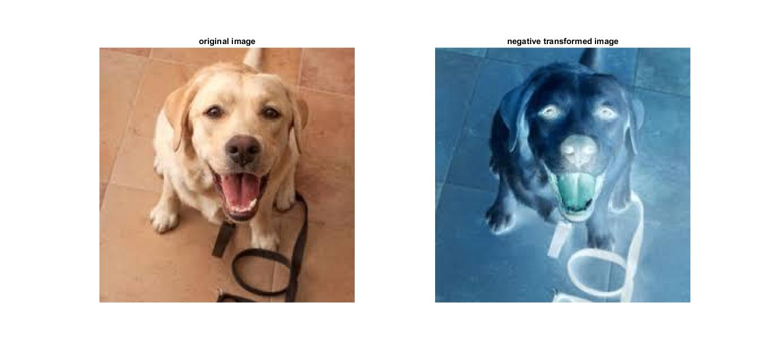
TRANSFORMATION USING 2D CURVES

Slide 9
TRANSFORMATION USING 2D CURVES
LOG TRANSFORMATION
Logarithmic Transformation is used to increase the contrast of lower intensity of the images. This transformation makes images looks brighter. And the brightness depends on the constant c.
The equation representing Log Transformation is f(x) =c*log (1+x), where c is a constant which govern how bright the image will be and x is the input intensity. This is useful when we have to see thing which is no clear due to lower contrast and in lower intensity that is darker.

Slide 10
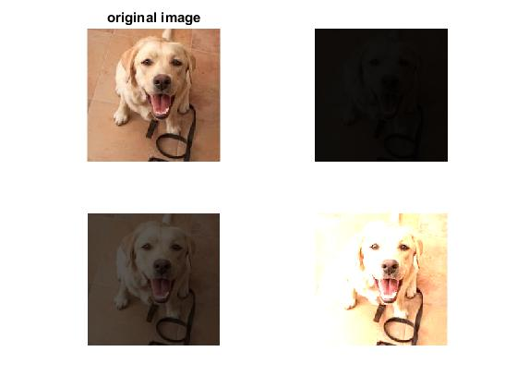
TRANSFORMATION USING 2D CURVES
Log transformation c=.1
Log transformation c=.5
Log transformation c=2.5

Slide 11
TRANSFORMATION USING 2D CURVES
GAMMA TRANSFORMATION
Gamma Transformation can brighten the intensity or darken the intensity. So the brightening or darkening depend on the value of gamma (the exponent) which can increase (or decrease) the intensity and thus the resultant image will be brighter (or darker).
The equation representing this transformation is f(x)=c*(x)^(gamma), where c is a constant used for keeping the value of intensity in some range and gamma is used to control the curve that is the intensity.

Slide 12
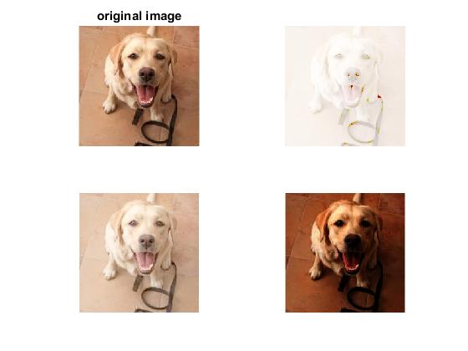
TRANSFORMATION USING 2D CURVES
Gamma Transformation g=.1
Gamma Transformation g=..5
Gamma Transformation g=2.5

Slide 13
TRANSFORMATION USING 2D CURVES
CONTRAST STRETCHING TRANSFORMATION Basically the contrast is the difference of the maximum intensity to the minimum intensity. So Contrast-Stretching Transformation increases the contrast. So it stretch the histogram to fit in the intensity domain. It will darken the darker and brighten up the brighter thus increasing the contrast of the image.
The equation representation is f(x)= 1/(1+(m/(x + eps ))^E) , where m is the mid-line the threshold value from where the transformation in either side is happening, eps is a constant which is distance between two doubles used to prevent divide by zero, E is used to control the slope of the function that is the intensity value.

Slide 14
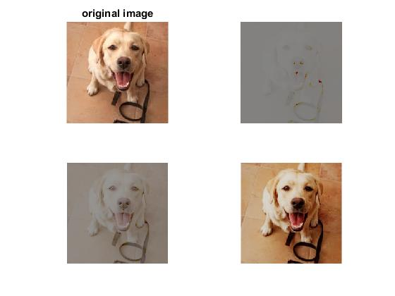
TRANSFORMATION USING 2D CURVES
Transformed e=0.1
Transformed e=0.5
Transformed e=2.5

Slide 15

TRASNFORMATION USING 3D CURVES
ELLIPSIOD TRANSFORMATION
The general equation of an ellipsoid is
When z=1, then put the value of z=1 and x as input matrix and y as a output matrix, which is also transformed image. Y can contain complex number, so take absolute value into consideration. And this is done for all the 3d curves that I have used in my experiment.

Slide 16
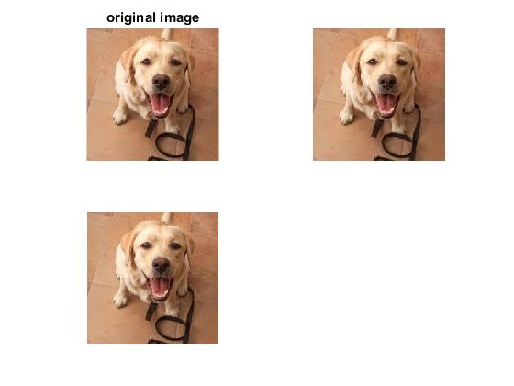
TRASNFORMATION USING 3D CURVES

Slide 17

TRASNFORMATION USING 3D CURVES
CONE TRANSFORMATION
The general equation of a cone is
We discrete z into some constant value and then put the value of z, and taking x as input (original image ) and getting y as transformed image .

Slide 18
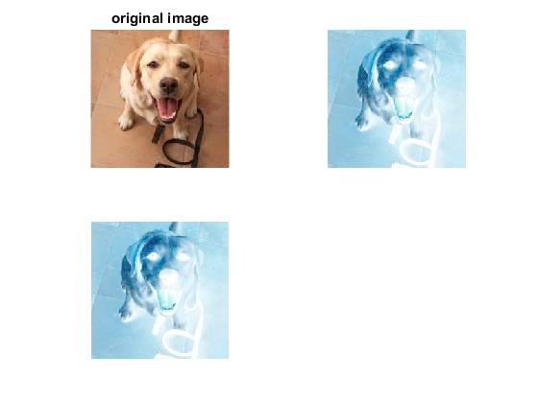
TRASNFORMATION USING 3D CURVES
Transformed z=-1
Transformed z=1
Transformed z=3

Slide 19

TRASNFORMATION USING 3D CURVES
HYPERBOLOID-ONE-SHEET TRANSFORMATION
The general equation of a hyperboloid in one sheet is
Here also I have done same thing just discrete z into some values and for each value get a 2d curve and apply that 2d curves on the image.

Slide 20
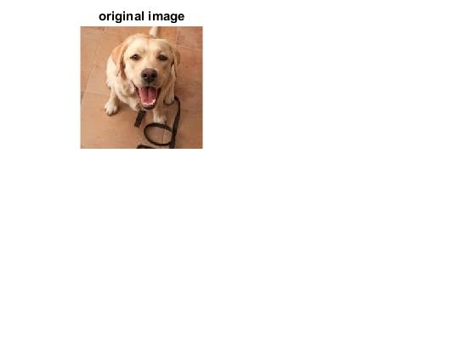
TRASNFORMATION USING 3D CURVES
Transformed z=-1
Transformed z=1
Transformed z=3

Slide 21

TRASNFORMATION USING 3D CURVES
HYPERBOLOID-TWO-SHEET TRANSFORMATION
The general equation of hyperboloid in two sheets is
same thing is done as done so far for 3d curves.

Slide 22
TRASNFORMATION USING 3D CURVES
Transformed z=-1
Transformed z=1
Transformed z=3

Slide 23

TRASNFORMATION USING 3D CURVES
ELLIPTIC PARABOLOID TRANSFORMATION
The general equation for elliptic paraboloid is
done same...

Slide 24
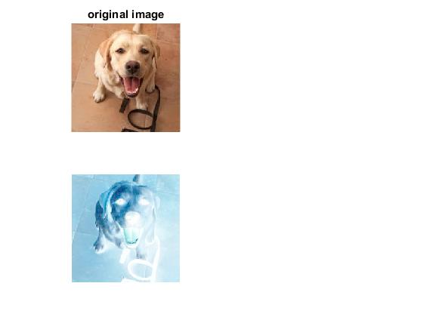
TRASNFORMATION USING 3D CURVES
Transformed z=-1
Transformed z=1
Transformed z=3

Slide 25

TRASNFORMATION USING 3D CURVES
HYPERBOLIC PARABOLOID TRANFORMATION
The general equation for Hyperbolic Paraboloid is
repeat same...

Slide 26
TRASNFORMATION USING 3D CURVES
Transformed z=-1
Transformed z=1
Transformed z=3

Slide 27
Calculation of Randomness ( pvalue)
Frequency Test or Mono-bit test –
The basic idea is that the number of zeroes and ones expected to be same in any random sequence of bit generated by any random number generator (RNG) or pseudo random number generator(PRNG).
The length of the string is represented by n and the sequence of bit is represented by E=E1,E2,E3.....En;. Now the test is calculated as test statistic Sobs=|Sn|/sqrt(n), where Sn =(no_of_ones - no_of_zeroes). The reference distribution for the test statistic is half normal distribution X=Sobs/sqrt(2);
Now pvalue=1-erfc(X), where erfc is complemented error function .
Decision rule is made at 1% level that is 0.01 value, if p-value is <0.01 then conclude that the sequence is non-random, and if p-value is >= 0.01 then conclude the sequence is random.

Slide 28
Calculation of Randomness ( pvalue)
Steps for calculating Randomness
calculateRandomness(){
im=imread(); //Read Image
im=im2double(im); //change into double
X=any_transformation_function_2d_3d(im); // apply transformation
diff=abs(im-abs(x));// diff of two matrix
convMat= MatrixConversion(diff);
pvalue=FrequencyTest(convMat);
}

Slide 29
Calculation of Randomness ( pvalue)
Steps for calculating Randomness
MatrixConversion( im){
median=find_median_of_im;
for_each element x in im
if x<median
convert x to 0;
if x>=median
convert x to 1;
return im;
}

Slide 30
Calculation of Randomness ( pvalue)
Steps for calculating Randomness
FrequencyTest ( convMat ){
l=numel(convMat); // total no of elements in matrix
calculate Total no of one
calculate total no of zeroes
sn=abs(Total_no_of_ones-total_No_of_zeors);
sobs=sn/sqrt(l);
X=sobs/sqrt(2);
pvalue=q-erfc(X);
return pvalue;
}

Slide 31
Calculation of image quality
Peak Signal To Noise Ratio ( PSNR) –
peak signal-to-noise ratio (PSNR) is the ratio between the maximum possible pixel of a image and the pixel of corrupting noise that affect the fidelity of its representation. It is expressed in terms of the logarithmic decibel scale
Psnr defined via mse(mean squared error) where mse=sum((I(:)-K(:)).^2)/numel(I); and mse is mean squared error , numel is matlab function which return no of elements. Psnr is defined as psnr=20.log10(Maxi)-10log10(mse);
Since we are converting our original image using im2double and making the transformation the pixel values will be in 0 to 1 thus Maxi=1; and psnr=-10log10(mse) if mse is zero the psnr==INF means two images are identical, if mse is inf the psnr==-INF means we cannot compute the psnr as the reconstructed matrix contains infinity

Slide 32
Calculation of image quality
Structural Similarity (SSIM) –
SSIM (Structural similarity) is calculated over various windows of an image but I am considering whole image as a window. ssim(X,Y)=((2*mean_X*mean_Y+c1)(2*covariance_x_y+c2))/((mean_x^2+mean_y^2+c1)(variance_x^2+variance_y^2+c2));
mean_x=mean(X(:));
mean_y=mean(Y(:));
variance_x=var(X(:));
variance_y=var(Y(:));
covariance_x_y=sum((X(:)-mean_x).*(Y(:)-mean_y))/numel(X);
c1=(k1*L)^2 c2=(k2*L)^2
k1=0.01 k2=0.03 and L= dynamic range of pixel values

Slide 33
Calculation of image quality
Steps to calculate image Quality
[psnr, ssim] imageQuality() {
orig=imread(‘image_name’); //read original image
orig=im2double(im); //change it into double
X=getTransformedMatrixFromCsv(‘test_name’);
reconstructedImg = Reverse_transformation(X);
psnr = mypsnr (orig, reconstructedImg);
ssim = myssim (orig, reconstructedImge);
}
[ X ] getTransformedMatrixFromCsv( test_name){
mat=csvread(test_name);
first_element=mat(1,1);
if first_element ==3
transform the mat into n_by_m_by_3
return mat;
}

Slide 34
Calculation of image quality
Steps to calculate image quality
[ psnr ] mypsnr ( orig, reconstructed ){
calculate mse(orig, reconstructed );
psnr = calculate using the formula
}
[ssim] myssim(orig, reconstructed){
calculate mean of orig
calculate mean of reconstructed
calculate variance of orig
calculate variance of reconstructed
calculate covariance of orig and reconstructed
c1=0.03*(max_pixel)
c2=0.01*( max_pixel)
calculate the value of ssim using formula as described in ssim section
}

Slide 35
Twists
In order to generate test files what I have done is created a csv file to store transformed image, because saving it using simply imwrite() requires a bit of encoding and decoding of image to get back the same intensities of the transformed image.
In case of 3d image I have created a separate file for real part of intensities and imaginary part of intensities in order to get back the original intensities
When calculating various values like pvalue, psnr and ssim, and while plotting the image in case of 3d transformation we are required to have used the absolute values of the used matrix because matrix may containing complex number.

Slide 36
Results
Results are kept in separate excel sheet in their respective folders ( in 2d curves and 3d curves ).
2d curves
randomnessandquality.xlsx
randomnessvsthreshold.xlsx
psnr and ssim of reconstructed image.xlsx
3d curves
RandomnessAndQulaityofTransformedImage.xlsx
RandomenssVsThresholdofTransformedImageusingSurvfacecurves.xlsx
RandomnessAndQualityofReconstructedImage.xlsx

Slide 37
Conclusion
I have applied every standard intensities transformation function and also some 3d function by keeping their z axis constant to find out the quality and the randomness they produce.
I found out that log transformation produces same transformation for all values of c.
Negative transformation produces higher randomness of almost 1 .
In terms of quality contrast stretching transformation produces good quality.
For the randomness I have used different values of median and found out that if we change the median value slightly then the randomness increase towards 1.
When doing the reconstruction of image we get almost the same image quality of the original image on seeing the value of psnr and ssim for the values of the parameter that we have used to create test cases on applying all the transformation with different parametric values.

Slide 38
references
Used images in my experiment are random.
For the calculation purpose I have used Matlab.
For the definition of psnr and ssim I have used Wikipedia.
For the frequency test and other functions I have used various online present materials.
The link to downloads all the documents and matlab program used in the process is
https://drive.google.com/drive/folders/1Ku5t30nL4iOiSfIn_Ai6actAX_ZVBjWW?usp=sharing

Slide 39
Functions used
imread( )
im2double( )
NegativeTransfomation( )
LogTransformation( )
GammaTransformation( )
ConstrastStretchingTransformation( )
absolutediff( )
MatrixConversion( )
FrequencyTest( )
storeTransformedMatrixInCsv( )
getTrasnformedMatrixFromCsv ()

Slide 40
Functions used
ReverseofNegativeTrasnformation()
ReverseOfLogTransformation()
ReverseOfGammaTrasnformation()
ReverseofContrastStretching()
mypsnr ( )
myssim( )
EllipsiodTransformation()
ConeTransformation( )
HyperboloidOneSheetTransformation()
HperboloidTwoSheetTrasnformation()
EllipticParaboloidTransformation()
HyperbolicParaboloidTransformation( )

Slide 41
Functions used
storeTransformedMatrixInCsv()
getTransformedMatrixFromCsv()
ReverseEllipsiodTransformation()
ReverseConeTransformation( )
ReverseHyperboloidOneSheetTransformation()
ReverseHperboloidTwoSheetTrasnformation()
ReverseEllipticParaboloidTransformation()
ReverseHyperbolicParaboloidTransformation()

